Slide 2
TASK ANALYSIS

Slide 3
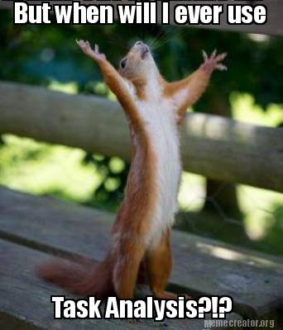
Task analysis allows you to
Assess your rhetorical situation
Understand what you want your document to achieve
This is not the same a reading through a list of assignment requirements.
If you haven’t already downloaded the “Task Analysis Worksheet” from Module 2, please do so now.

Slide 4
Step One: Get Familiar
Have a good read through of the request for information. Are you responding to
An assignment
A request for proposals
A request for a technical description

Slide 5
Step Two: Genre
What kind of a document would best fulfill this communication task?
A proposal
A 20-page report
An email
A presentation
A memo?
Think about the particular constraints and benefits of your document choice

Slide 6
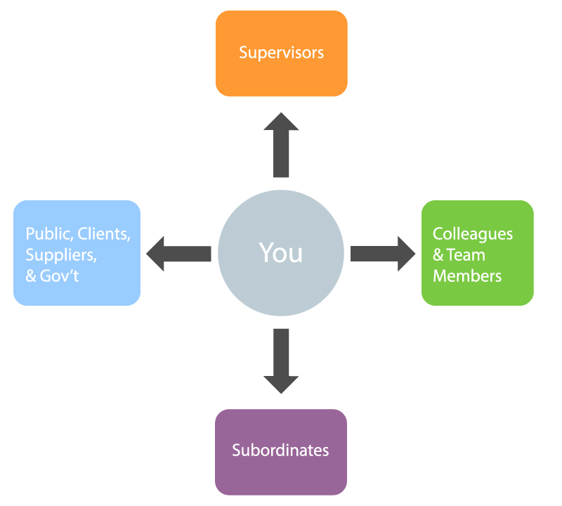
Step Three: Audience Analysis
What is your position in relation to your target audience?
Your boss
Your employees
Your co-workers?
Considering your relationship with your audience, what kind of tone should you use?

Slide 7
Step Four: Purpose
Think about what the communication goal is for this document. Are you
Asking for money?
Asking for approval?
How will you persuade your audience? Which of the rhetorical appeals will you use?

Slide 8
Step Five: Knowledge
What information and knowledge can you assume the audience already has?
How does it compare to your level of information and knowledge?
How will you include information at the appropriate knowledge level so that the document is successful?
Literature review?
Technical description?
Weighted objectives chart?

Slide 9
Step Six: Interest
How much does your audience care about what you’re about to communicate? What is their attitude towards this topic?
How will your audience’s interest effect your tone and persuasion method?

Slide 10
Step Seven: Needs
In addition to communicating effectively, what information do you need to deliver so that your audience can make an informed decision?
After reading your document, will your audience know what the next steps are?
Do not assume that a reader will infer your meaning.

Slide 11
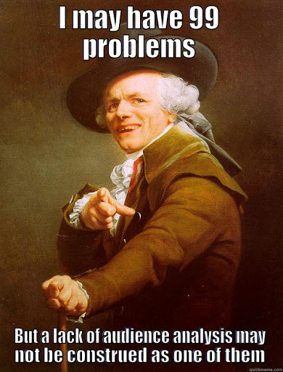
A successful task and audience analysis
Provides a clear overview of your rhetorical situation
Provides a clear outline of what a successful document will achieve

